Slide 1
Access Specifiers -
Java has four access specifiers - public, private, protected and default. 1- public - public access specifier provide the widest possible visibility level. A public member is accessible everywhere regardless of package. 2- protected - protected members can be accessed in any class within the same package and inheriting classes i.e. subclasses in other packages. 3- default - If any member does not have any access specifier defined then by default it will have default access specifier. Default members can be accessed by any classes but classes should be within the same package. 4- private - private members are accessible only within the class in which they are defined.
Example -

Slide 2
package A;
class First {
private int a=1; int b=2;
protected int c=3;
public int d =4;
}
public class Demo {
public static void main(String[] args) {
First f1 = new First();
//System.out.println(f1.a); //Not accessible because a is private System.out.println(f1.b);
System.out.println(f1.c); //accessible b/c both classes are in the same package System.out.println(f1.d);
}
}

Slide 3
package B;
class Second extends A.First
{
public Second() {
//a =10; //Not accessible because a is private.
// b =20; //Not accessible because default members are not accessible in other package.
c =30; // Accessible because 'Second' class is inheriting the class 'First'
d =40; // Accessible, public members are always accessible everywhere.
}
}
Note :- protected members (c variable in our example) can be accessed in any class within the same package (as in class 'Demo') and inheriting classes i.e. subclasses in other packages (as in class 'Second'). But they will not be accessible in classes those exist in some other packages, and classes there do not inherit the class containing protected members.

Slide 4
abstract Keyword -
Always remembers the following points about abstract -
Abstract can be classes and methods. We cannot declare variables as abstract.
We cannot create objects of abstract classes using new keyword.
An abstract class may or may not contain abstract methods.
If a class contains any abstract method then it is compulsion to declare the class as abstract.
An abstract method does not have any body. We have to override them if we want to work with them.

Slide 5
Example 1 -
class First
{
}
abstract class Second
{
}
public class Call
{
public static void main(String[] args)
{
First f1 = new First(); // Works fine Second
s1 = new Second(); // Error - Second is abstract; cannot be instantiated
}
}
In the above example we cannot create object of Second class because it is abstract.

Slide 6
Example 2 -
abstract class Marks
{
private int phy, chem;
public void input() {
phy = Integer.parseInt(System.console().readLine("Enter physics marks"));
chem = Integer.parseInt(System.console().readLine("Enter chemistry marks"));
}
public void disp()
{
System.out.println(phy+" "+chem);
}
}
class Temp extends Marks
{
}
public class Call {
public static void main(String[] args) {
Temp t1 = new Temp();
t1.input();
t1.disp();
}
}

Slide 7
In the above example Marks class is abstract, so we cannot create objects of this class. In such cases if we want to access members of the class, then we can inherit the class. So we create a second class named Temp and inherit Marks class. Now all public members of Marks class are also available in Temp class, so we can access them by creating objects of Temp class.
Example 3 -
abstract class Marks
{
private int phy,chem;
public void input()
{
phy = Integer.parseInt(System.console().readLine("Enter physics marks")); chem = Integer.parseInt(System.console().readLine("Enter chemistry marks"));
}
public void disp()
{
System.out.println(phy+" "+chem);
}

Slide 8
abstract public void show(); //abstract method
}
class Temp extends Marks
{
public void show()
{
System.out.println("Just a Demo");
}
}
public class Call
{
public static void main(String[] args)
{
Temp t1 = new Temp();
t1.input();
t1.disp();
t1.show();
}
}

Slide 9
In the above example Marks class contain an abstract method named show(), And always remember that if a class contain any abstract method then that class should also be abstract. In this case if we do not override show() method in Temp class, then we also have to declare Temp class abstract. Because Temp is inheriting Marks class, so show() method is also available in Temp class and as rule says we have to declare class abstract if it contain any abstract method. So we override show() method and now no need to declare Temp class as abstract.

Slide 10
final Keyword -
It is used to finalize something that we cannot change. final can be classes, methods and variables. final variable -
If we declare any variable as final then once the value is assigned to it, we cannot change it.
Example -
class Test
{
private int a;
private final int b, c=300;
public Test()
{
a = 100;
b = 200;
//c = 300; Error, cannot assign a value to final variable c.
}

Slide 11
public Test(int x, int y)
{
a = x;
b = y;
}
public void setA(int x)
{
a = x;
}
public void setB(int y)
{
// b = y; Error, cannot assign a value to final variable c.
}
public void disp() {
System.out.println(a+" "+b+" "+c);
}
}
public class Call {
public static void main(String[] args)
{
Test t1 = new Test();
t1.disp();
Test t2 = new Test(10, 20);
t2.disp();
}
}

Slide 12
Here we have declared 3 variables a, b and c, out of them b and c are final. Variable c has assigned a value 300, so we cannot change it, that is why we are also not able to initialize it in any constructor and simple method. Variable b is not initialized to any value so we can initialize them in constructors. Note that we cannot initialize final variables in simple methods. Because only constructor gives guarantee that it will run only once for any object whereas methods can run any number of times. So methods can change the value of variables for any objects and that is not possible for final variables.

Slide 13
final methods -
Once a method is declared as final, we cannot override it. That is we cannot change its definition.Example -
class Test1 {
public void disp() {
System.out.println("Test1 Disp");
}
public final void show() // or final public void show()
{
System.out.println("Final Method, So cannot change definition");
}
}
class Test2 extends Test1
{
public void disp() {
System.out.println("Test2 Disp");
}

Slide 14
/*
public void show() We cannot override final methods { System.out.println("No way");
}
*/
}
public class Call
{
public static void main(String[] args)
{
Test2 t1 = new Test2();
t1.disp();
t1.show();
}
}

Slide 15
final class -
We cannot override final classes.Example -
final class Test1
{
}
class Test2 extends Test1 //Error, cannot inherit final classes
{
}
Note - abstract and final are reverse of each other i.e. abstract need to be override and final cannot be override. So we cannot use abstract and final at the same time.

Slide 16
static keyword -
static can be variables, methods and only inner classes.
static variables -
static variables are common to all objects i.e. we cannot create separate copies of static variables for objects.
Example -
class Test
{
private int a = 0;
private static int b = 0;
public Test()
{ a++;
b++;
}

Slide 17
public void setA(int x)
{
a = x;
}
public void setB(int y)
{
b = y;
}
public void disp() {
System.out.println(a+" "+b);
}
}
public class Call {
public static void main(String[] args) {
Test t1 = new Test();
t1.disp();
Test t2 = new Test();
t2.disp();
Test t3 = new Test();

Slide 18
t3.disp();
t1.setB(10);
t1.disp();
t2.disp();
t3.disp();
}
}
Output -
1 1
1 2
1 3
1 10
1 10

Slide 19
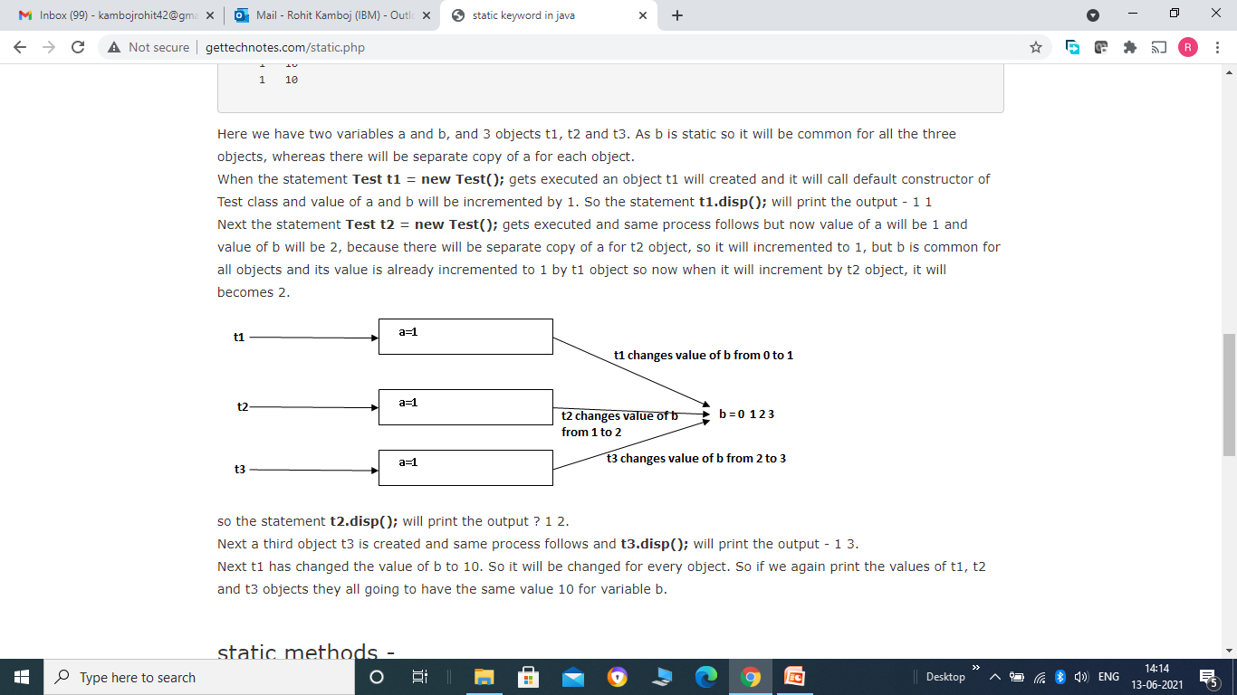

Slide 20
static methods -
We can access static methods without creating any object by using class name directly. Always remember that within static methods we can only have static members.
Example –
class Test {
private int a = 0;
private static int b = 0;
public Test()
{ a++;
b++;
}
public void setA(int x)
{
a = x;
}
public void setB(int y)
{
b = y;
}

Slide 21
public void disp()
{
System.out.println(a+" "+b);
}
static public void show()
{
System.out.println(b); // we cannot access a here.
}
}
public class Call
{
public static void main(String[] args)
{
Test t1 = new Test();
t1.disp();
Test.show(); // calling static method by class name
}
}

